Slide 1
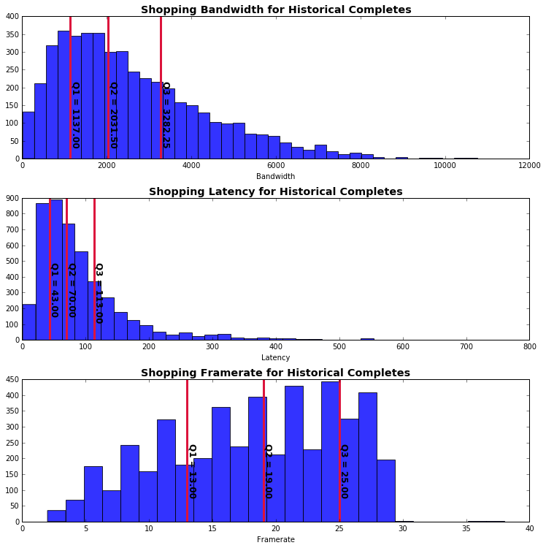
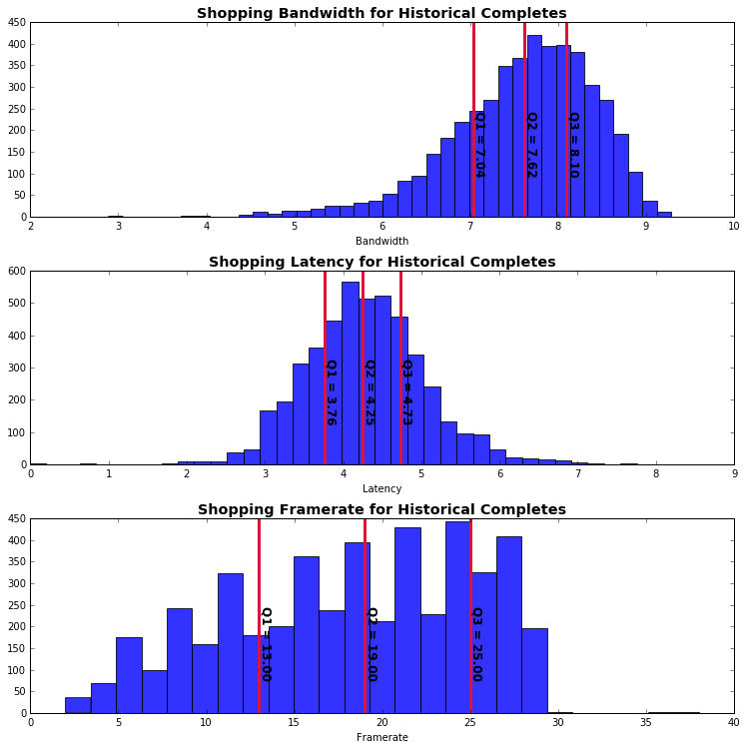
Historical Frame Shopping Data
Left plots show the data before transforms. Right is after the transform.

Slide 2
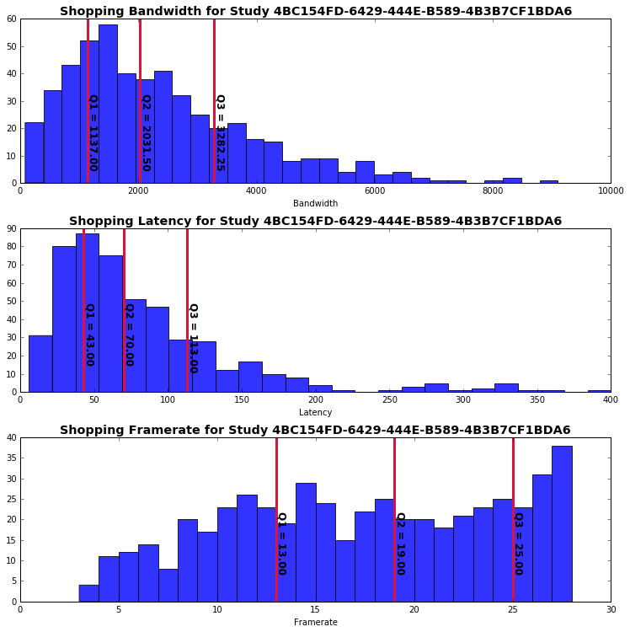
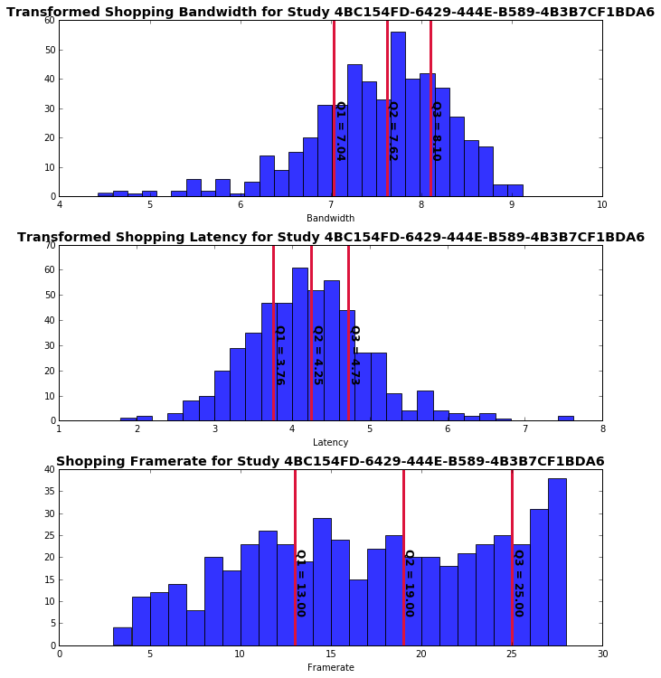
Frame Shopping Data for Jarden

Slide 3
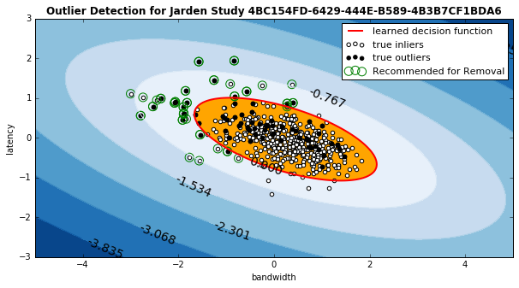
Frame Removal Classifier

